Slide 1


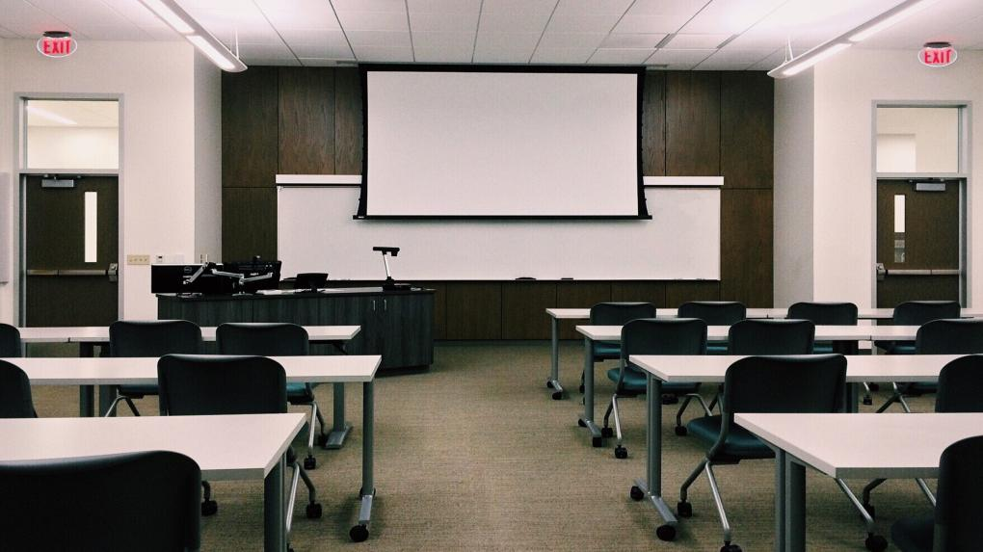


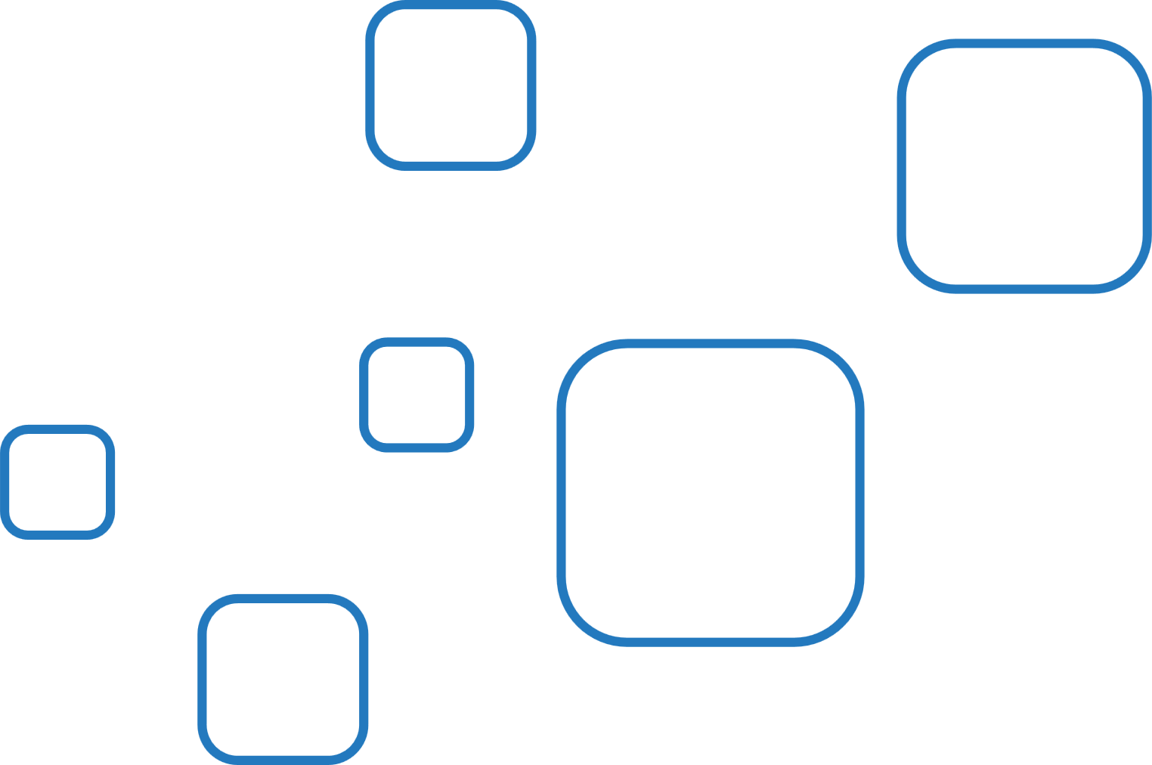



Use of
Digital Media
In Education
Presentation By
Jenish Khanal
Anish Bishwokarma

Slide 2




Table Of Content
What is Digital Media and Why It Matters?
Benefits of Digital Media in Education
Challenges of Digital Media in Education
Solutions and Recommendations
Different Forms of Digital Media in Education
Bibliography
Acknowledgement

Slide 3
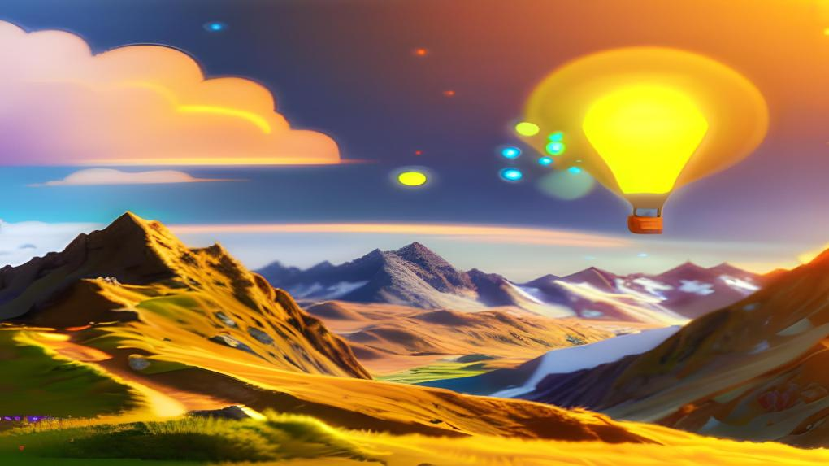

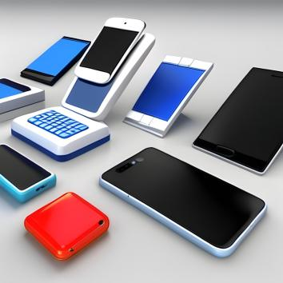


What is Digital Media and Why It Matters?
Digital media is a wonderful way to express, share, and enjoy content, using electronic devices that can create, display, or play videos, images, text, or audio.
We use digital media every day for information, entertainment, and communication. It is made and used by electronic devices like smartphones, laptops, or TVs. It helps us learn, communicate, and engage with the world. Let’s see what digital media is and why it matters.

Slide 4






Benefits of Digital Media in Education
Access: More information and resources for learning and research.
Interactivity: Customized and engaging learning experiences.
Collaboration: Better communication and teamwork among learners and educators.
Digital literacy: Essential skills and competencies for the 21st century.
Innovation: More creativity and originality in education.

Slide 5


Challenges of digital media in education
Digital divides: Unequal access, skills, and resources among learners and educators.
Ethical and legal issues: Privacy, security, intellectual property, and quality concerns of digital media.
CHALLENGES
Investment and support: High costs and efforts to integrate digital media in education.
Pedagogical changes: New roles and responsibilities for learners and educators.

Slide 6





Solutions and Recommendations
Providing legal and ethical awareness.
Promoting Digital Etiquette.
Educate users about safeguarding personal information and data privacy.
Solutions
and Recommendations
Providing Access to Knowledge and Skills

Slide 7

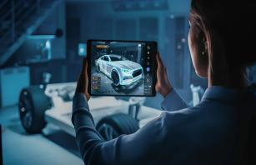


Different Forms of Digital Media in Education
E-books and Online Textbooks
Online Quizzes and Assessments
Educational Apps
Interactive Whiteboards and Smartboards
Educational Videos
Augmented Reality (AR) and Virtual Reality (VR)

Slide 8








Any Queries ?

Slide 9



Acknowledgement
"Special thanks to all our teachers for their guidance and support in preparing this presentation. Your encouragement drives us to excel. Thank you for shaping our learning journey."

Slide 10



Bibliography
"We've used various sources, including AI tools for image generation, Canva app images, AI sources like ChatGPT, and Bing, to create this presentation, and we'd like to thank them. Here's a shout-out to all the sources that helped us along the way:"

Slide 11

THANK YOU

